Slide 1
Cloud Migrations

Slide 2
Introduction
What is a Cloud Migration?
Benefits
Strategies
Challenges
Cloud Deployment Models
Cloud Service Models
Role of the CSD

Slide 3
What is a Cloud Migration?
Migration of workloads, assets, in or out of a cloud environment.
This can include physical or virtual servers, services, apps, data etc.
My experiences of migrations
The most common types of migration are lift and shift (rehost), replatform and refactor (or re-architect). There’s also the option to retire or retain.
There are many benefits to migrating to the cloud, as well as potential pitfalls.
There are various cloud deployment models and service models.
Notes:
Cloud migration is the process of transferring digital assets, such as data and applications, in and out of cloud environments. The most common type of cloud migration involves shifting enterprise assets from on-premise data centers to the cloud. However, there are other types.
When enterprise assets are already located in the cloud, and the enterprise shifts the information to a different cloud, the process is called cloud-to-cloud migration. Enterprises can also perform a reverse cloud migration, and shift assets from the cloud to a local data center.

Slide 4
Cloud Migration Benefits
Less operating costs
Faster time to market
Scalability and utilisation
Reducing upfront costs for new projects
Application modernisation
Notes:
Less operating costs - enterprises deploying assets to the cloud do not need to set up and manage their own data centers. This significantly reduces overhead typically allocated for hardware and in-house IT.
Faster time to market - cloud vendors provide ready-made automation tools and features that enable enterprises to shorten deployment cycles and quickly release new features.
Scalability and utilization - traditional on-premise systems were designed for peak loads, utilizing less than 20% of their capacity. Cloud platforms enable enterprises to consume only the resources needed during each period.
Reducing upfront costs for new projects - cloud computing models offer flexible payment options, like “pay-as-you-go”, reducing upfront investment in licensing and hardware.
Application modernisation - cloud vendors offer services and technologies that help enterprises modernise development and IT processes and create agile and efficient pipelines.

Slide 5
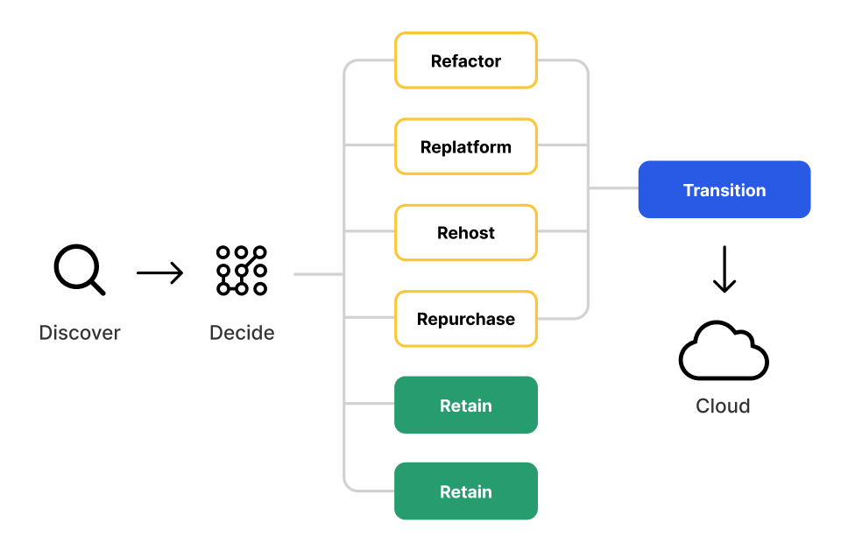
Cloud Migration Strategies
Notes:
Rehosting (Lift and Shift)
Rehosting is a cloud migration strategy that involves “lifting” applications, data, as well as physical and virtual servers, from one location, and “shifting” the assets into another location, without making changes to the migrated assets.
It is possible to lift and shift assets only when the migrated assets are compatible with the new environment.
Replatforming
Replatforming is a cloud migration strategy that involves making minor changes to the codebase before migrating from one location to another.
Typically, re-platforming is performed to ensure the asset performs optimally when placed in the new environment or adding new features. Enterprises choose re-platforming because it is often a cost-effective strategy. However, if the scope changes during the implementation, overhead might accumulate due to excessive modifications.
Repurchasing
Repurchasing is a cloud migration strategy that involves discontinuing existing legacy systems in favor of using a cloud-based service. This process might involve repurposing services on new platforms and ending previous licensing.
Enterprises choose to repurchase when their legacy system is not compatible with the target cloud environment and business needs require a change.
Refactoring
Refactoring is a cloud migration strategy that involves modifying the entire codebase. The goal is to ensure the asset is completely compatible with the new target environment, before making the move to the cloud.
Enterprises typically choose this strategy when the application is business or mission-critical, but a move to the cloud is necessary.
Retiring
Retiring is a decision to discontinue the use of certain datasets and applications, typically when the assets no longer justify their cost. When enterprises plan a migration implementation, they assess existing assets, as well as the scope of the project. To reduce costs, migration complexity, and security risks, enterprises might decide to retire certain assets.
Retaining
Retaining is a decision to keep certain digital assets, rather than retiring them. In this case, if the asset is not compatible with the main target cloud environment, the enterprise might decide to implement a hybrid cloud strategy. Enterprises decide to retain assets for technical, security, compliance, or economical purposes.

Slide 6
Cloud Migration Challenges
All new security, governance, support, operational issues.
Upskill existing teams or costly outsourcing
Poor planning
Vendor lock-in

Slide 7
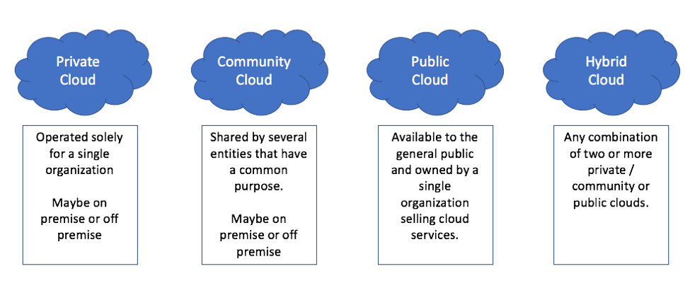
Cloud Deployment Models
Public Cloud
Private Cloud
Hybrid
Community
Multi-Cloud
Notes:
Public Cloud - The public cloud makes it possible for anybody to access systems and services. The public cloud may be less secure as it is open for everyone. The public cloud is one in which cloud infrastructure services are provided over the internet to the general people or major industry groups.
Advantages of the public cloud model:
Minimal Investment: Because it is a pay-per-use service, there is no substantial upfront fee, making it excellent for enterprises that require immediate access to resources.
No setup cost: The entire infrastructure is fully subsidized by the cloud service providers, thus there is no need to set up any hardware.
Infrastructure Management is not required: Using the public cloud does not necessitate infrastructure management.
No maintenance: The maintenance work is done by the service provider (Not users).
Dynamic Scalability: To fulfill your company’s needs, on-demand resources are accessible.
Private Cloud - The private cloud deployment model is the exact opposite of the public cloud deployment model. It’s a one-on-one environment for a single user (customer). There is no need to share your hardware with anyone else. The distinction between private and public cloud is in how you handle all of the hardware.
Advantages of the private cloud model:
Better Control: You are the sole owner of the property. You gain complete command over service integration, IT operations, policies, and user behavior.
Data Security and Privacy: It’s suitable for storing corporate information to which only authorized staff have access. By segmenting resources within the same infrastructure, improved access and security can be achieved.
Supports Legacy Systems: This approach is designed to work with legacy systems that are unable to access the public cloud.
Customization: Unlike a public cloud deployment, a private cloud allows a company to tailor its solution to meet its specific needs.
Hybrid - By bridging the public and private worlds with a layer of proprietary software, hybrid cloud computing gives the best of both worlds. With a hybrid solution, you may host the app in a safe environment while taking advantage of the public cloud’s cost savings.
Advantages of the hybrid cloud model:
Flexibility and control: Businesses with more flexibility can design personalized solutions that meet their particular needs.
Cost: Because public clouds provide for scalability, you’ll only be responsible for paying for the extra capacity if you require it.
Security: Because data is properly separated, the chances of data theft by attackers are considerably reduced.
Community Cloud - It allows systems and services to be accessible by a group of organizations. It is a distributed system that is created by integrating the services of different clouds to address the specific needs of a community, industry, or business. The infrastructure of the community could be shared between the organization which has shared concerns or tasks. It is generally managed by a third party or by the combination of one or more organizations in the community.
Advantages of the community cloud model:
Cost Effective: It is cost-effective because the cloud is shared by multiple organizations or communities.
Security: Community cloud provides better security.
Shared resources: It allows you to share resources, infrastructure, etc. with multiple organizations.
Collaboration and data sharing: It is suitable for both collaboration and data sharing.
Multi-Cloud - We’re talking about employing multiple cloud providers at the same time under this paradigm, as the name implies. It’s similar to the hybrid cloud deployment approach, which combines public and private cloud resources. Instead of merging private and public clouds, multi-cloud uses many public clouds. Although public cloud providers provide numerous tools to improve the reliability of their services, mishaps still occur. It’s quite rare that two distinct clouds would have an incident at the same moment. As a result, multi-cloud deployment improves the high availability of your services even more.
Advantages of a multi-cloud model:
You can mix and match the best features of each cloud provider’s services to suit the demands of your apps, workloads, and business by choosing different cloud providers.
Reduced Latency: To reduce latency and improve user experience, you can choose cloud regions and zones that are close to your clients.
High availability of service: It’s quite rare that two distinct clouds would have an incident at the same moment. So, the multi-cloud deployment improves the high availability of your services.

Slide 8
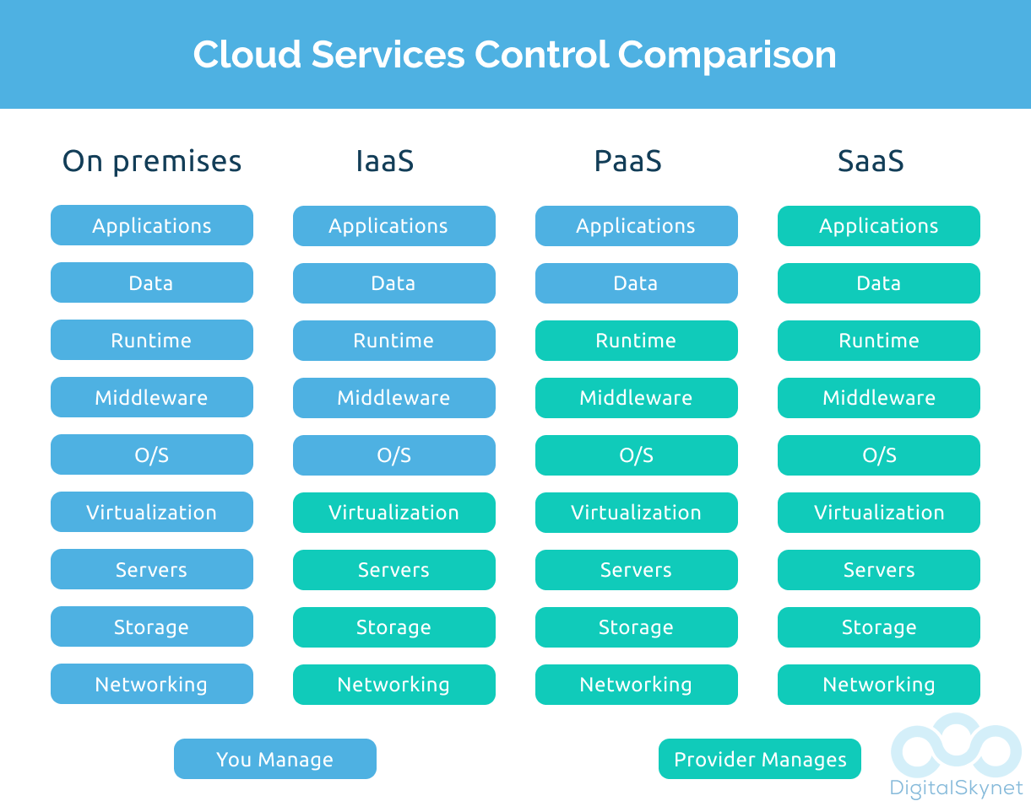
Cloud Service Models
Infrastructure-as-a-Service (IaaS)
Platform-as-a-Service (PaaS)
Software-as-a-Service (SaaS)
<insert-term>-as-a-Service (XaaS)

Slide 9
Role of the CSD
Build landing zones
Write Terraform
Perform migration tasks
Knowledge transfers
Troubleshooting issues
Support and handover

Slide 10
Any Questions?

